Slide 1
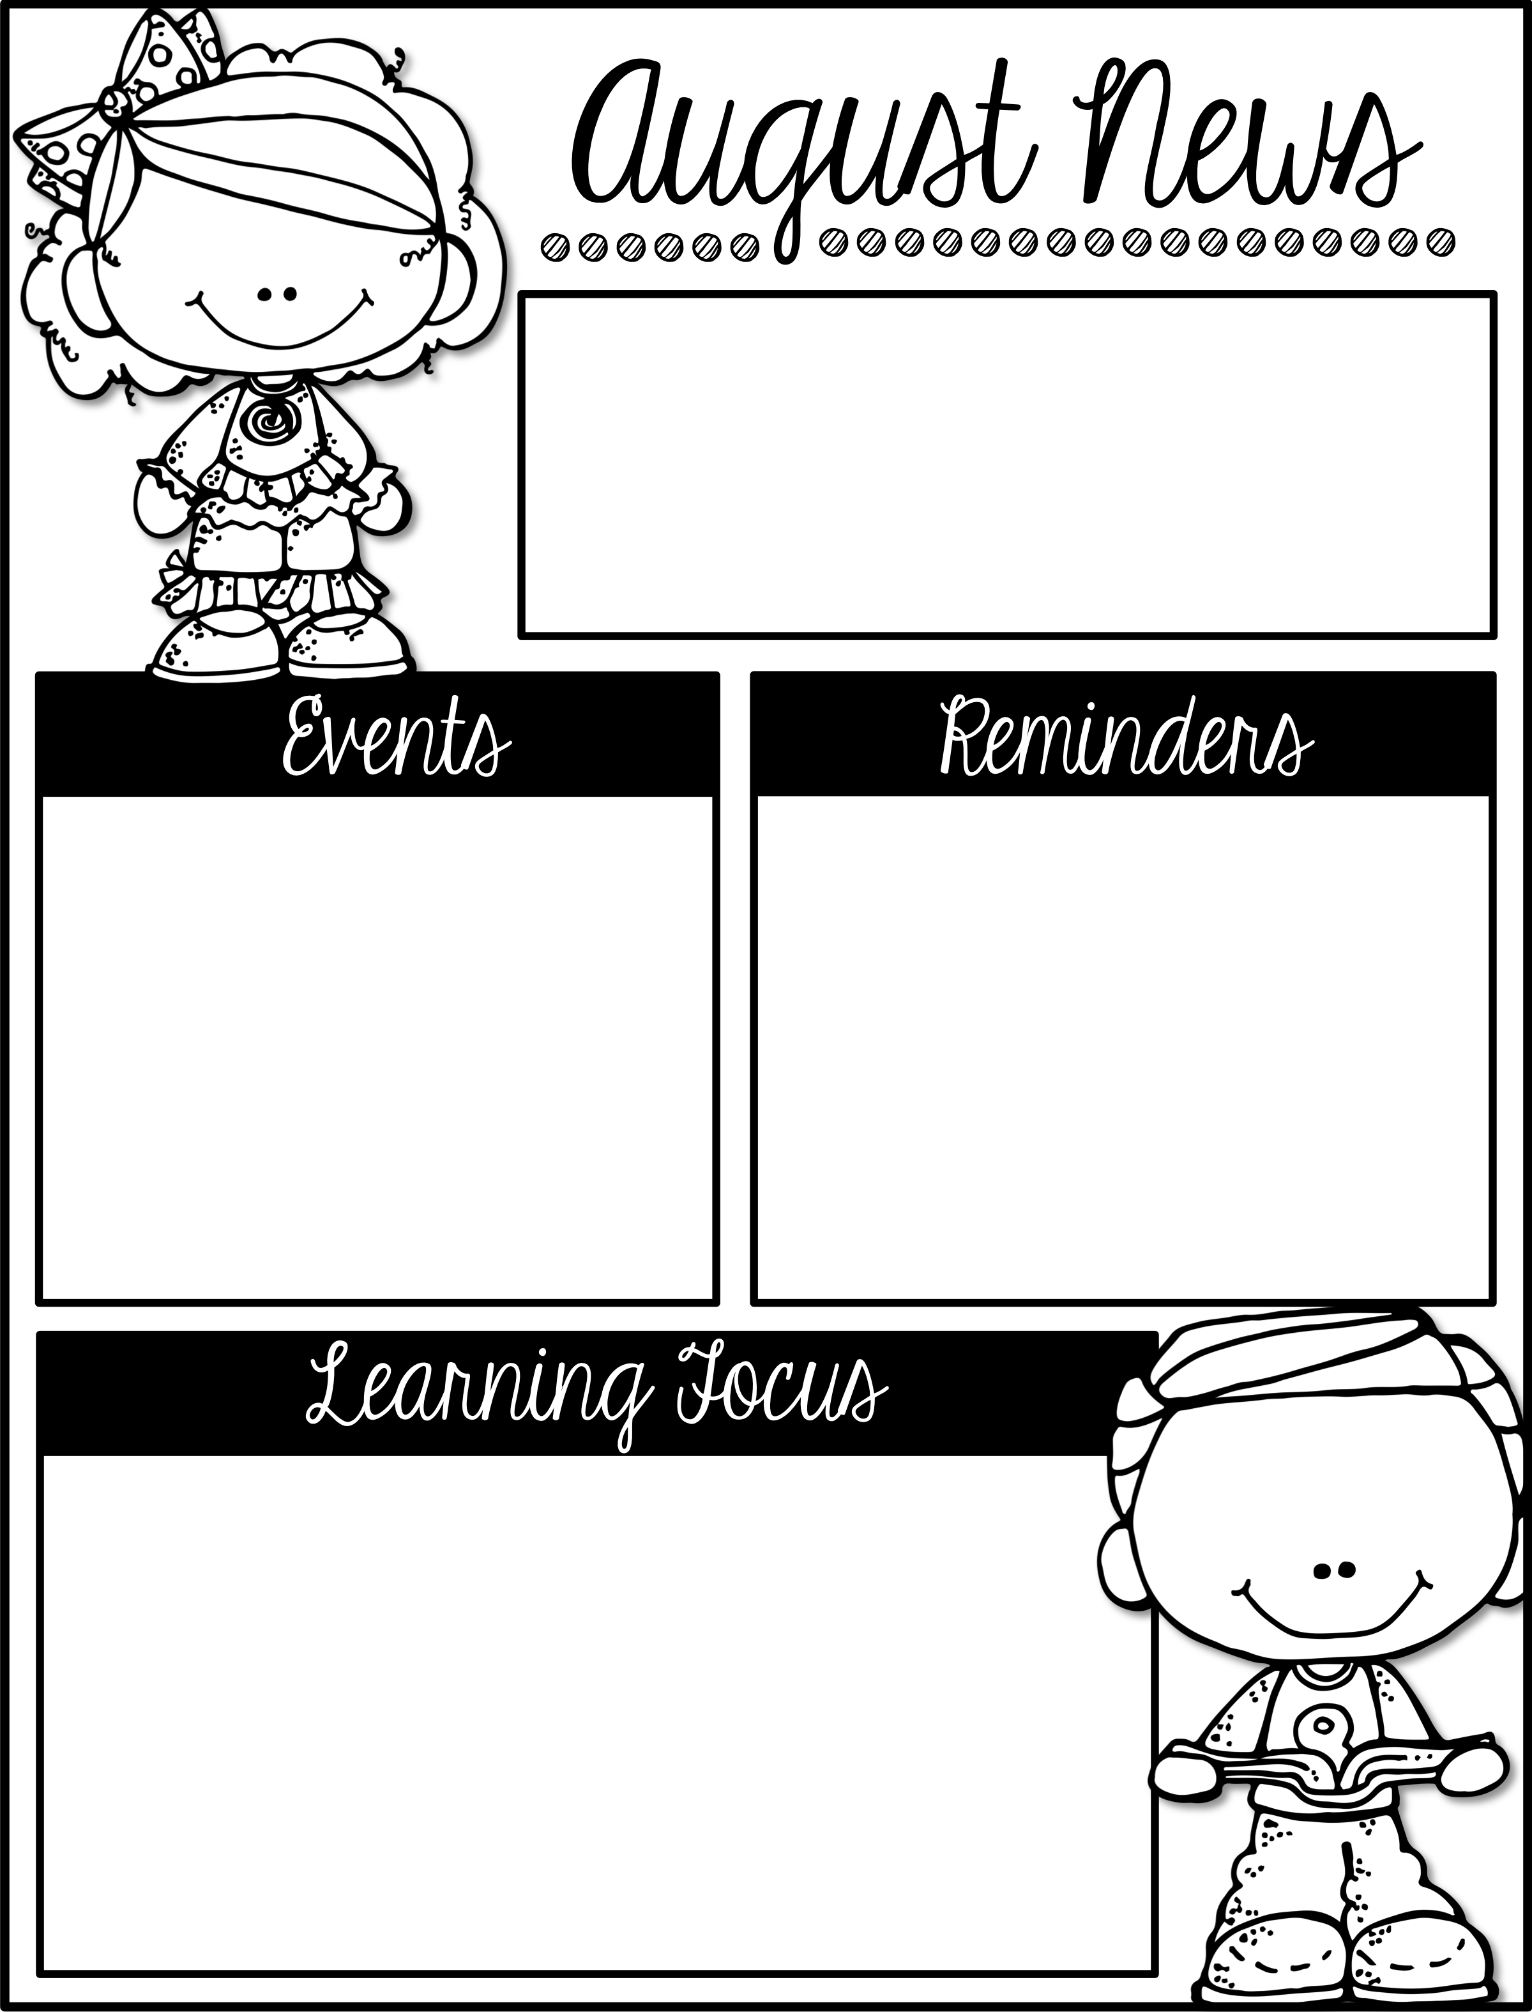
September 11th – 15th
Mrs. Nauss’ 2nd Grade Class
Please feel free to reach me with any questions/concerns at mnauss@stellamarisacademy.org!
STAR Testing for 2nd grade will be on WEDNESDAY, 9/13 and FRIDAY, 9/15 from 8:15-9am. Please make sure your student is at school ON TIME, especially on these days!
Please sign your students up for after school classes (Yoga, Lego Engineering, and Spanish). They begin this week!
Homework
Events
Homework can be checked weekly on the “Homework” link on our website second.stellamarisacademy.org
Every Day Read 15-20 min. & record on monthly reading calendar
Monday Reading
Tuesday Reading & Math pg. 7-8
Wednesday Reading & Math pg. 9-10
Thursday Reading & Math pg. 11-12
Friday Reading
Monday, 9/11 8 am Morning Mass
Tuesday, 9/12 8:15 Room Parent Meeting
Wednesday, 9/13 STAR Reading Test 8:15-9
Thursday, 9/14 School Photo Make-Ups
Our 1st Mystery Reader
Friday, 9/15 STAR Math Test 8:15-9
$ Denim Day
Mrs. George’s Baby Shower (K-2) @ 11:30 am
Learning Targets
English Language Arts (ELA): Daily 5 routines and CAFÉ (comprehension, accuracy, fluency, expanded vocabulary) strategies and Read-to-Self practice. DIBELS and DRA testing to assess students’ reading levels.
Math: Math Mountains – relationship between addition and subtraction (fact families). Odd and even numbers.
Social Studies: Starting our first unit, “People Now and Long Ago.”
Science: The scientific method & properties of matter – design-your own pencil lab.
Religion: Discussing “Jesus Christ Gives Us the Church.” Vocab: disciples, Apostles, Resurrection, and Church.
Specials: Scheduled as usual. Art is working on cat pictures related to a book about homophones.

